Slide 1
Leon valley 2025 PROPOSED RATES review
James Hoelscher, PE
Byron Sanderfer, PE, CPM
Phillip Givens, Superior Management

Slide 2
agenda
Rate Study Scope
Examine Current Rates
Assumption in Projections
Rate Proposal As Requested
Other Options to Consider
Preliminary Examinations of Options

Slide 3
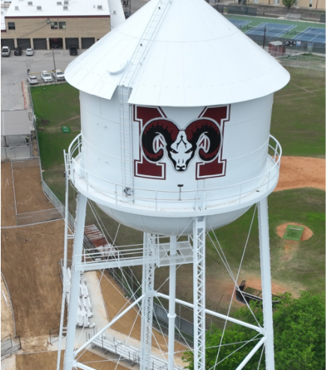
Rates Proposal - Scope
City has requested Ardurra and team to evaluate existing rates for sustainability and potential rate adjustments to cover system operating costs.
City of Leon Valley Water & Sewer Capital Improvement Plan (in process), has potential to require an additional ~$500,000 per year to water and sewer budgets once enacted. ($1,000,000 total)

Slide 4
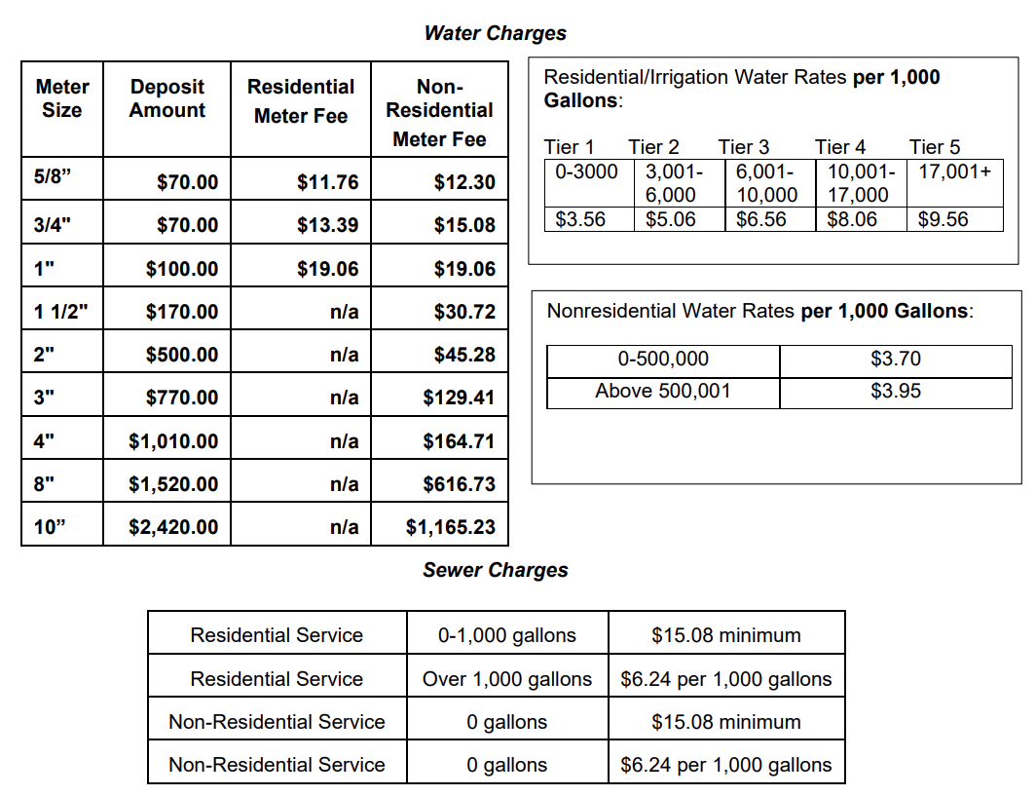

Slide 5
Current rates – sample bill & notes
City requested presenting average residential water bill
Average residential customer uses about 5,000 gallons per month
Note: there are fees not noted in the previous table that are accounted for in real bills (and sample bill)
Edwards Aquifer Availability Fee
$0.62 / 1,000 gallons usage
TCEQ Fee
0.5% of total bill

Slide 6
Current rates - sample Residential bill
5,000 GAL/MONTH | $
Water – Base Fee | $11.76
Water – Usage Charge | $20.80
EAA Fee | $3.10
Sewer – Base Fee (Includes 1,000 gal) | $15.08
Sewer – Usage Charge (above 1,000 gal) | $24.96
TCEQ Fee | $0.38
TOTAL | $76.08

Slide 7
revenue projection assumptions
Revenue projections are based on usage data from 2022
301,245,000 gallons billed for by LV
2,643 total meters in water system
2,518 total customers in sewer system
Revenue from meter fees are calculated as shown on the right.
Meter count provided by city, 2022 data
Meter Size | # of cust. | Meter Fee | Rev/Yr
$5/8$”, $3/4"$ | 2,305 | $11.76 | $342,921.60
1” | 59 | $19.06 | $13,494.48
1-1/2” | 86 | $30.72 | $31,703.04
2” | 55 | $45.28 | $29,884.80
3” | 11 | $129.41 | $17,082.12
4” | 1 | $164.71 | $1,976.52
8” | 1 | $616.73 | $7,400.76
Total Revenue Water Meter Fee |  |  | $444,463.32
Meter Size | # of cust. | Base Fee | Rev/Yr
All Cust. | 2,518 | $15.08 | $455,657.28
Total Revenue Sewer Base Fee |  |  | $455,657.28

Slide 8
Current Rates – Revenue Projections
WATER UTILITY | $
Meter Fee | $444,463.32
Usage Charge | $1,548,082.20
Revenue Estimate | $1,992,545.52
Actual Sales (22-23) | $2,020,985.00
Budgeted Sales (2025) | $2,119,100.00
SEWER UTILITY | $
Base Rate Charge | $455,657.28
Usage Charge | $1,691,220.96
Revenue Estimate | $2,146,878.24
Actual Sales (22-23) | $2,563,039.00
Budgeted Sales (2025) | $2,508,000.00
Usage is calculated based on the average cost per 1,000 gallons for 9,500 gallons of usage / month
(301,245,000 gallons/yr)/(2,643 total meters)
~9,500 gallons/month
$5.14 / 1,000 gal in current rates
Actual revenue from 2022-2023 is given to show how our projections are conservative

Slide 9
Summary – first Proposal
For sake of cost security and sustainability, all expenses the system defines as necessary to keep system running will be considered “fixed costs”
GOAL: Ensure system will have all fixed costs, upcoming CIP costs included, covered even in low usage years by raising base rate revenue
Residential water meter fee proposed:
Existing: $11.76
Proposed: $44.91
Sewer base rate proposed:
Existing: $15.08
Proposed: $75.79
Usage fee adjusted to $0.50 / 1,000 gallons for all tiers
Current sewer charge structure has first 1,000 gallons of usage included in base rate.
It is recommended to change this so all usage is accounted and paid for.

Slide 10
First Proposal
Lowest bill would go up 250%
(0 gallons of usage)
Average bill would rise 60%
(5,000 gallons of usage)
After declining first proposal, City Council requested Ardurra to evaluate:
Raising Meter Fee and Usage Charge 2% annually for 5 years
Matching Water Usage Tiers to SAWS
Raise EAA fee from $0.62 to $0.70/1,000 gal
Edwards Aquifer Authority is raising charge to city, this is a pass-through charge.

Slide 11
Proposed Water Rates For Standard Residential Meter
Water | Base Rate | $/1,000 gallons
 |  | 0-3,000 | 3,001-6,000 | 6,001-10,000 | 10,001-17,000 | 17,001+
Existing | $11.76 | $3.56 | $5.06 | $6.56 | $8.06 | $9.56
Water | Base Rate | $/1,000 gallons
 |  | 0-4,000 | 4,001-7,000 | 7,001-12,000 | 12,001-20,000 | 20,001+
Year 1 | $12.00 | $3.63 | $5.16 | $6.69 | $8.22 | $9.75
Year 2 | $12.24 | $3.70 | $5.26 | $6.83 | $8.39 | $9.95
Year 3 | $12.48 | $3.78 | $5.37 | $6.96 | $8.55 | $10.15
Year 4 | $12.73 | $3.85 | $5.48 | $7.10 | $8.72 | $10.35
Year 5 | $12.98 | $3.93 | $5.59 | $7.24 | $8.90 | $10.56
Flat 2% increase on base rate and usage charge rates annually

Slide 12
Sample water Bill & Water Revenue projections
5,000 gallons | $
Existing | $32.56
Year 1 | $31.68
Year 2 | $32.31
Year 3 | $32.96
Year 4 | $33.62
Year 5 | $34.29
Only accounts for water
 | Projected Revenue | % Change
Existing | $1,992,545.52 | -
Year 1 | $1,935,363.83 | -2.9%
Year 2 | $1,974,071.11 | -0.9%
Year 3 | $2,013,552.53 | 1.1%
Year 4 | $2,053,823.58 | 3.1%
Year 5 | $2,094,900.05 | 5.1%

Slide 13
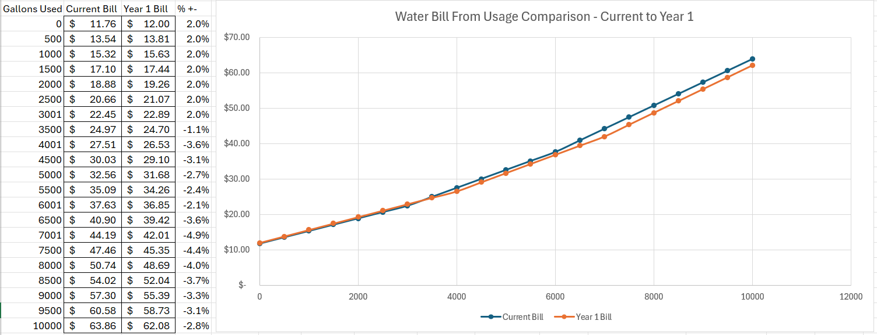
Effect of usage tiers adjustment in conjunction with % increase proposed

Slide 14
Other options to consider
Continue utilizing existing Usage Tiers
Evaluate x% annual increase
Keep rates as current and add a “Capital Improvements Fee”
As additional flat fee or based on usage
Utilize SAWS Usage Tiers and adjust Usage Charges to better match existing billing.
Evaluate annual x% increase after

Slide 15
Existing usage tiers remain with 2% increase proposed water Rates For Standard Residential Meter
Water | Base Rate | $/1,000 gallons
 |  | 0-3,000 | 3,001-6,000 | 6,001-10,000 | 10,001-17,000 | 17,001+
Existing | $11.76 | $3.56 | $5.06 | $6.56 | $8.06 | $9.56
Water | Base Rate | $/1,000 gallons
 |  | 0-3,000 | 3,001-6,000 | 6,001-10,000 | 10,001-17,000 | 17,001+
Year 1 | $12.00 | $3.63 | $5.16 | $6.69 | $8.22 | $9.75
Year 2 | $12.24 | $3.70 | $5.26 | $6.83 | $8.39 | $9.95
Year 3 | $12.48 | $3.78 | $5.37 | $6.96 | $8.55 | $10.15
Year 4 | $12.73 | $3.85 | $5.48 | $7.10 | $8.72 | $10.35
Year 5 | $12.98 | $3.93 | $5.59 | $7.24 | $8.90 | $10.56

Slide 16
Existing usage tiers remain with 2% increase proposed sewer Rates For Standard Residential Meter
Sewer | Base Rate | $/1,000 gallons
 |  | Per 1,000 gallons over 1,000 gallons
Existing | $15.08 | $6.24
Sewer | Base Rate | $/1,000 gallons
Year 1 | $15.38 | $6.36
Year 2 | $15.69 | $6.49
Year 3 | $16.00 | $6.62
Year 4 | $16.32 | $6.75
Year 5 | $16.65 | $6.88

Slide 17
Existing usage tiers remain with 2% increase Sample Bill projections
5,000 GAL/MONTH | Existing | Year 1 | Year 2 | Year 3 | Year 4 | Year 5
Water – Base Fee | $11.76 | $12.00 | $12.24 | $12.48 | $12.73 | $12.98
Water – Usage Charge | $20.80 | $21.22 | $21.64 | $22.07 | $22.51 | $22.96
EAA Fee | $3.10 | $3.50 | $3.50 | $3.50 | $3.50 | $3.50
Sewer – Base Fee | $15.08 | $15.38 | $15.69 | $16.00 | $16.32 | $16.65
Sewer – Usage Charge | $24.96 | $31.80 | $32.44 | $33.08 | $33.75 | $34.42
TCEQ Fee | $0.38 | $0.42 | $0.43 | $0.44 | $0.44 | $0.45
TOTAL | $76.08 | $84.31 | $85.93 | $87.58 | $89.26 | $90.97
% Change from Existing | - | 11% | 13% | 15% | 17% | 20%
$ Change from Existing |  | $8.23 | $9.85 | $11.50 | $13.18 | $14.89

Slide 18
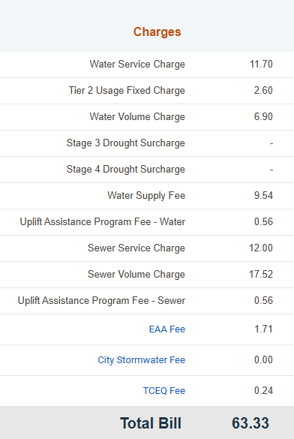
Existing usage tiers remain with 2% increase Comp to saws (outside city limits)
5,000 GAL/MONTH | Existing | Year 5
Water – Base Fee | $11.76 | $12.98
Water – Usage Charge | $20.80 | $22.96
EAA Fee | $3.10 | $3.50
Sewer – Base Fee | $15.08 | $16.65
Sewer – Usage Charge | $24.96 | $34.42
TCEQ Fee | $0.38 | $0.45
TOTAL | $76.08 | $90.97
% Change from Existing | - | 20%

Slide 19
Existing usage tiers remain with 2% increase Revenue projections
 | Existing | Year 1 | Year 5 | $ Difference Year 5 to Existing
Proj Rev Water | $1,992,545.52 | $2,032,396.43 | $2,199,931.26 | $207,385.74
% Change from Existing |  | 2.0% | 10.4%
Proj Rev Sewer | $2,146,878.24 | $2,380,688.63 | $2,576,933.93 | $430,055.69
% Change from Existing |  | 10.9% | 20.0%
Proj Rev Total | $4,139,423.76 | $4,413,085.06 | $4,776,865.19 | $637,441.43
% Change from Existing |  | 6.6% | 15.4%

Slide 20
Capital improvements fee
Keep rates as current and add a “Capital Improvements Fee” as a flat fee to both water and sewer
$15.76 water fee
($500,000/ 2,643 meters / 12 months)
$16.55 sewer fee
($500,000/ 2,518 meters / 12 months)
Lowest bill raised 120% (0 gallons used)
Average bill raised 43% (5,000 gallons)
5,000 GAL/MONTH | Existing | CIP Fee
Water – Base Fee | $11.76 | $11.76
Water – Usage Charge | $20.80 | $20.80
EAA Fee | $3.10 | $3.50
Sewer – Base Fee | $15.08 | $15.08
Sewer – Usage Charge | $24.96 | $24.96
TCEQ Fee | $0.38 | $0.54
CIP Water Fee | - | $15.76
CIP Sewer Fee | - | $16.55
TOTAL | $76.08 | $108.95
% Change from Existing | - | 43%

Slide 21
Capital improvements Usage fee
Keep water rates as current.
Charge for all sewer usage
Remove base fee coverage for first 1,000 gallons
Add a “Capital Improvements Fee” based on usage
Water CIP Fee - $1.63 / 1,000 gallons
Sewer CIP Fee - $0.88 / 1,000 gallons
5,000 GAL/MONTH | Existing | CIP Fee
Water – Base Fee | $11.76 | $11.76
Water – Usage Charge | $20.80 | $28.95
EAA Fee | $3.10 | $3.50
Sewer – Base Fee | $15.08 | $15.08
Sewer – Usage Charge | $24.96 | $36.22
TCEQ Fee | $0.38 | $0.48
TOTAL | $76.08 | $95.99
% Change from Existing | - | 26%

Slide 22
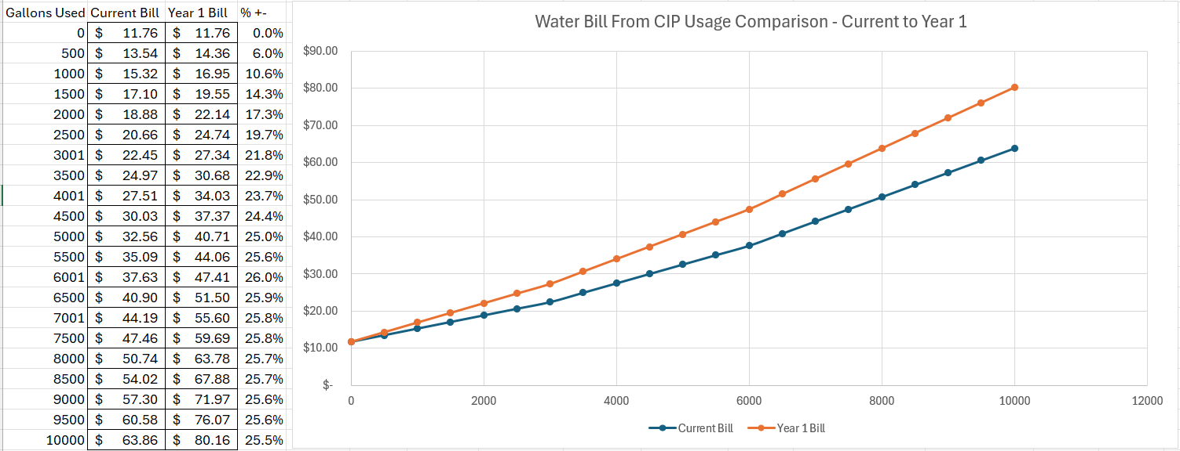
Effect of usage tiers adjustment in conjunction with % increase proposed

Slide 23
Cip usage fee Revenue projections
 | Existing | CIP Use Fee | $ Difference
Proj Rev Water | $1,992,545.52 | $2,492,545.52 | $500,000.00
 |  | 25.1%
Proj Rev Sewer | $2,146,878.24 | $2,646,878.24 | $500,000.00
 |  | 23.3%
Proj Rev Total | $4,139,423.76 | $5,139,425.76 | $1,000,000.00
 |  | 24.2%

Slide 24
Thank you for your time today
Questions?

