Slide 1
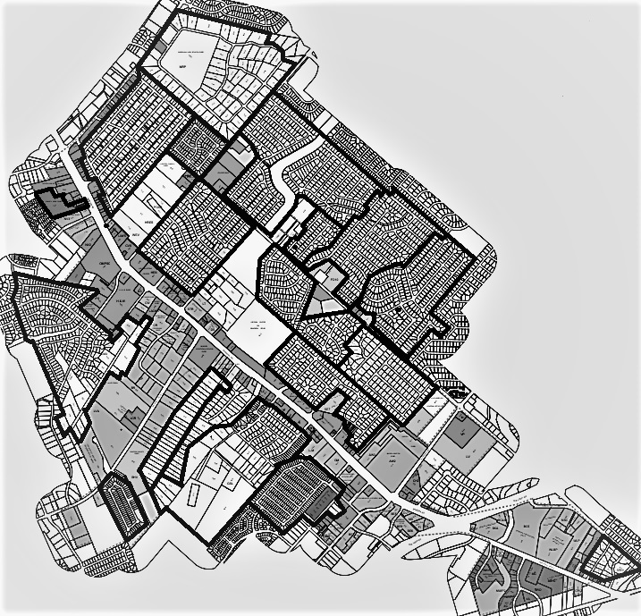
Leon Valley Neighborhood Officers
Monte Robles
M Sanchez
Canterfield
L Abajian
Forest Oaks
E Pena
Forest Oaks Estates
J Espinoza
Sun Valley
B Ramos
Castle Estates
A Griego
Seneca Estates
E Guadarrama
Brisa Estates
A Gonzalez
Rollingwood
A Gonzalez
Hodges/Althea
J Urbina
Linkwood
H Rodriguez
Pavona Place
J Fernandez
Grass Valley
G Castro
Bandera Pass
A Griego
Old Mill
J Orellana
Leon Valley Ranches
C Mandry
Seneca West
J Arambula
The Ridge
at Leon Valley
R Wigton
Shadow Mist
J Breton
Updated May 22, 2024

